Slide 1
Battery Management System For EV

Slide 2
Objective of BMS
A battery management system (BMS) is any electronic system that manages a rechargeable battery (cell or battery pack)
To Measure parameter like (Voltage, Current, Heat, Charging& Discharging.
To protect the battery from operating outside its safe operating area (SOA) and prolong its lifetime.
Monitoring its state continuously.
To perform battery cell balancing.
To determine the SoC
To determine the SoH
Total energy delivered since first use
Total operating time since first use
Total number of cycles

Slide 3
Battery Management System
V. I
measurement
BMS
Temp
measurement
Total Energy
Energy
Total Energy

Slide 4
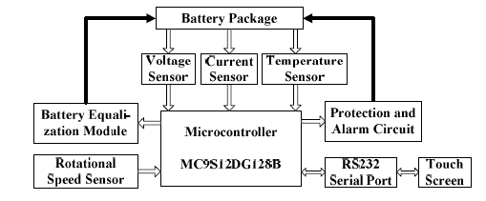
Battery Management System
BMS
Display

Slide 5
Functions of Battery management system
BMS may monitor the state of the battery as represented by various items, such as:
Voltage: total voltage, voltages of individual cells, minimum and maximum cell voltage or voltage of periodic taps
Temperature: average temperature, coolant intake temperature, coolant output temperature, or temperatures of individual cells
State of charge (SOC) or depth of discharge (DOD), to indicate the charge level of the battery
State of health (SOH), a variously-defined measurement of the remaining capacity of the battery as % of the original capacity
Current: current in or out of the battery

Slide 6
Additionally, a BMS may calculate values based on the above items, such as:
Maximum charge current as a charge current limit (CCL)
Maximum discharge current as a discharge current limit (DCL)
Energy [kWh] delivered since last charge or charge cycle
Internal impedance of a cell (to determine open circuit voltage)
Charge [Ah] delivered or stored (sometimes this feature is called Coulomb counter)
Total energy delivered since first use
Total operating time since first use
Total number of cycles

Slide 7
Methods Of SOC Estimation
Open Circuit Voltage Method
By measuring cell terminal voltage under load
Coulomb counting (current based) Method
Uses measured current by integrating the measured current over a time to keep track of how much charge has flowed out of or flows into the battery cell
Model based Method
In this method voltage and current measurement is integrated to estimate SOC
Kalman filter Method
- It is an algorithm to estimate the inner state of any dynamic system. In this case ,the SOC is estimated using current & voltage measurement.

Slide 8

Coulomb counting (currant SOC relation )
Measuring current(coulomb) in and out of the battery.
Accurate method but dependant on SOH and initial soc.
Change in soc = charge pumped in or out of battery / (initial capacity * SOH).
It is also known as current integration method
SOC is taken at previous time step and current taken is added & subtracted.
Current is taken and integrated over time to find SOC.

Slide 9
Protection
A BMS may protect its battery by preventing it from operating outside its safe operating area, such as:
Over-current (may be different in charging and discharging modes)
Over-voltage (during charging)
Under-voltage (during discharging), especially important for lead–acid and Li-ion cells
Over-temperature
Under-temperature

Slide 10
Thank You…

